Slide 1

Multimedia security and privacy
Section 1

Slide 2
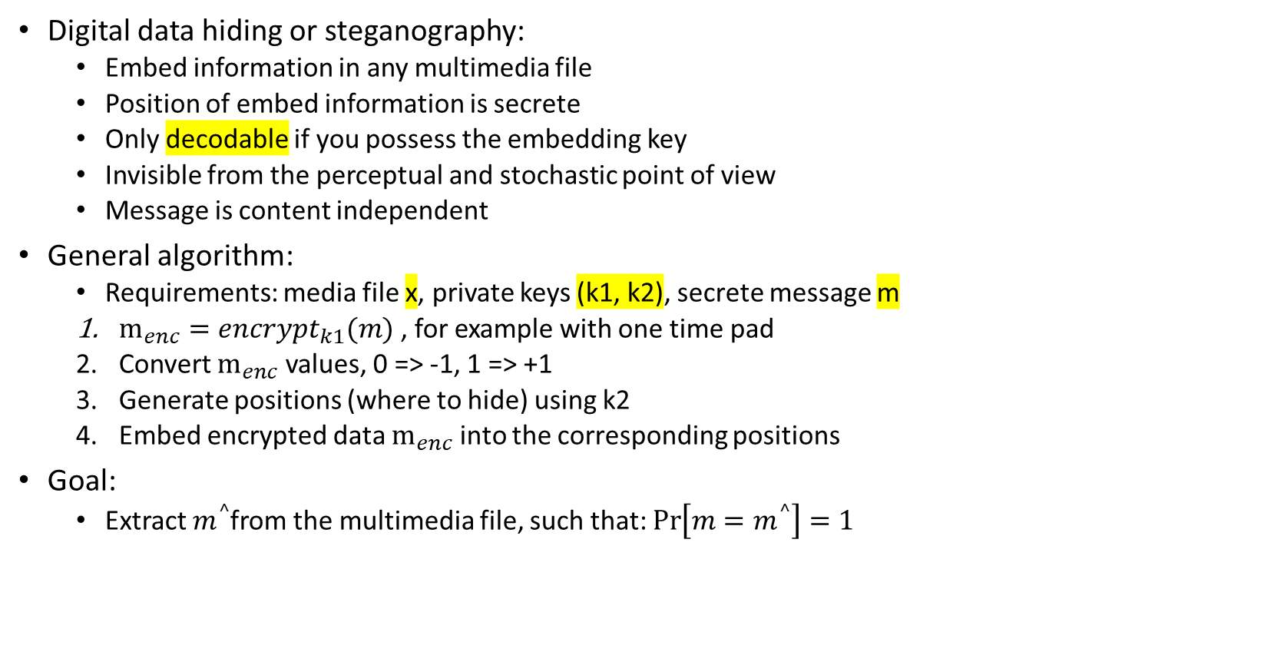
(1.1) Explain the difference in the usage of and requirements to digital robust watermarking steganography and tamper proofing.
Digital data hiding or steganography:
Embed information in any multimedia file
Position of embed information is secrete
Only decodable if you possess the embedding key
Invisible from the perceptual and stochastic point of view
Message is content independent
General algorithm:
Requirements: media file x, private keys (k1, k2), secrete message m
$m_{enc}=encrypt_{k1}(m)$ , for example with one time pad
Convert $m_{enc}$ values, 0 => -1, 1 => +1
Generate positions (where to hide) using k2
Embed encrypted data $m_{enc}$ into the corresponding positions
Goal:
Extract $m^{^}$from the multimedia file, such that: $\operatorname{Pr}\left[m=m^{^}\right]=1$

Slide 3
(1.1)
Digital robust watermarking:
Embed copyright information in any multimedia file
Position of embed information is secrete
Only detectable if you possess the embedding key
Invisible from the perceptual point of view
Message is content independent
General algorithm:
Requirements: media file x, private key k1
Generate positions (where to hide) using k1
Mark x, with mark k into generated positions
Goal:
Detect if there is a watermark => yes or no answer

Slide 4
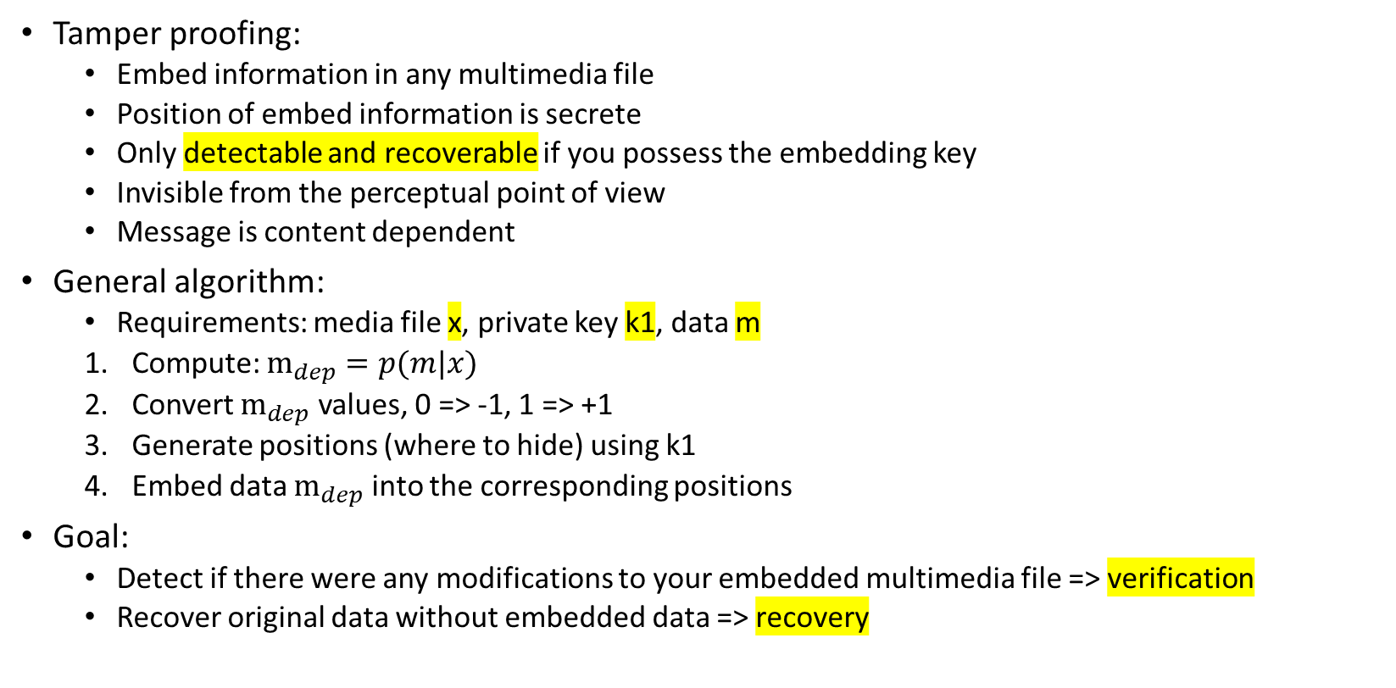
(1.1)
Tamper proofing:
Embed information in any multimedia file
Position of embed information is secrete
Only detectable and recoverable if you possess the embedding key
Invisible from the perceptual point of view
Message is content dependent
General algorithm:
Requirements: media file x, private key k1, data m
Compute: $m_{dep}=p(m|x)$
Convert $m_{dep}$ values, 0 => -1, 1 => +1
Generate positions (where to hide) using k1
Embed data $m_{dep}$ into the corresponding positions
Goal:
Detect if there were any modifications to your embedded multimedia file => verification
Recover original data without embedded data => recovery

Slide 5
(1.1)
Attacks:
Different types of digital data hiding will be attacked differently
In digital data hiding, attacks will try to (1) detect if a an multimedia file carries a hidden message, (2) cryptanalysis to get k and m
In digital robust watermarking, attackers will try to break the robustness, in other words, they want to (1) remove the copyright information without losing monetary value
In tamper proofing, the attacks are content modifications, we want to (1) detect if there was a lossy compression applied

Slide 6
(1.2) Explain the difference between the watermarking and data hiding. Explain the block diagrams and the difference between the decoding and detection problems.
Digital data hiding or steganography:
Embed information in any multimedia file
Position of embed information is secrete
Only decodable if you possess the embedding key
Invisible from the perceptual and stochastic point of view
Message is content independent
General algorithm:
Requirements: media file x, private keys (k1, k2), secrete message m
$m_{enc}=encrypt_{k1}(m)$ , for example with one time pad
Convert $m_{enc}$ values, 0 => -1, 1 => +1
Generate positions (where to hide) using k2
Embed encrypted data $m_{enc}$ into the corresponding positions
Goal:
Extract $m^{^}$from the multimedia file, such that: $\operatorname{Pr}\left[m=m^{^}\right]=1$

Slide 7
(1.2)
Digital robust watermarking:
Embed copyright information in any multimedia file
Position of embed information is secrete
Only detectable if you possess the embedding key
Invisible from the perceptual point of view
Message is content independent
General algorithm:
Requirements: media file x, private key k1
Generate positions (where to hide) using k1
Mark x, with mark k into generated positions
Goal:
Detect if there is a watermark => yes or no answer

Slide 8
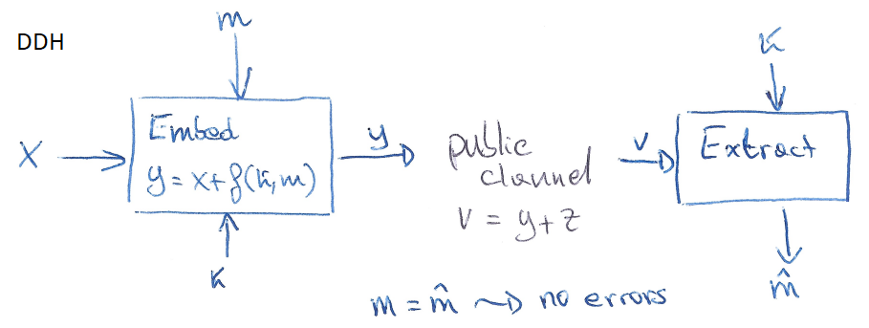
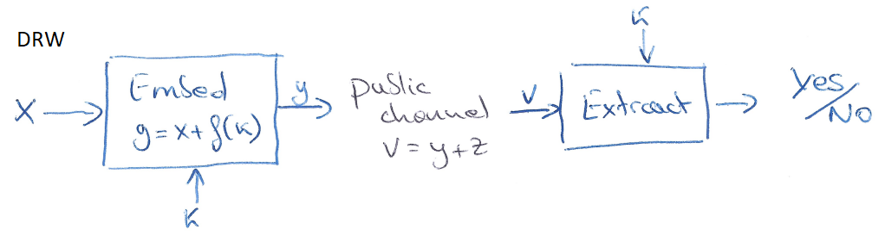
(1.2)
Attacks:
Different types of digital data hiding will be attacked differently
In digital data hiding, attacks will try to (1) detect if a an multimedia file carries a hidden message, (2) cryptanalysis to get k and m
In digital robust watermarking, attackers will try to break the robustness, in other words, they want to (1) remove the copyright information without losing monetary value

Slide 9
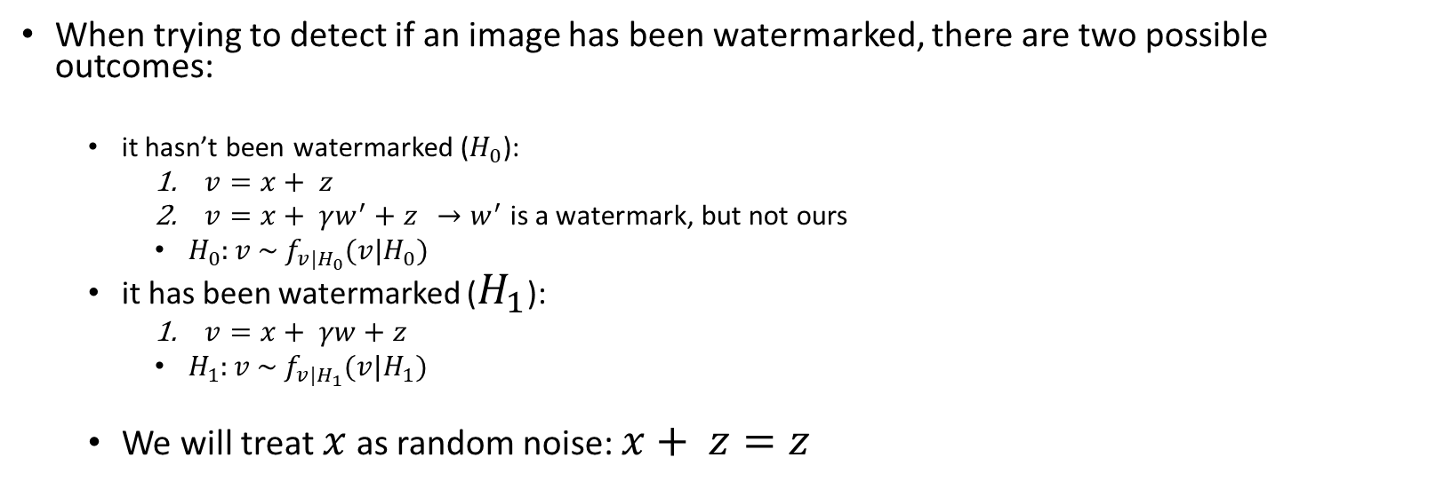
(1.3) Explain the watermark detection problem. Explain the difference between the Neyman-Pearson and Bayesian hypothesis testing. Explain the different types of errors.
When trying to detect if an image has been watermarked, there are two possible outcomes:
it hasn’t been watermarked ($H_{0}$):
$v=x+ z$
$v=x+ γw^{′}+z$ ${ →w}^{′}$ is a watermark, but not ours
$H_{0}:v \sim f_{v|H_{0}}(v|H_{0})$
it has been watermarked ($H_{1}$):
$v=x+ γw+z$
$H_{1}:v \sim f_{v|H_{1}}(v|H_{1})$
We will treat $x$ as random noise: $x+ z=z$

Slide 10
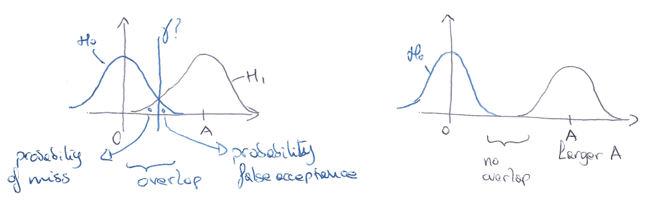
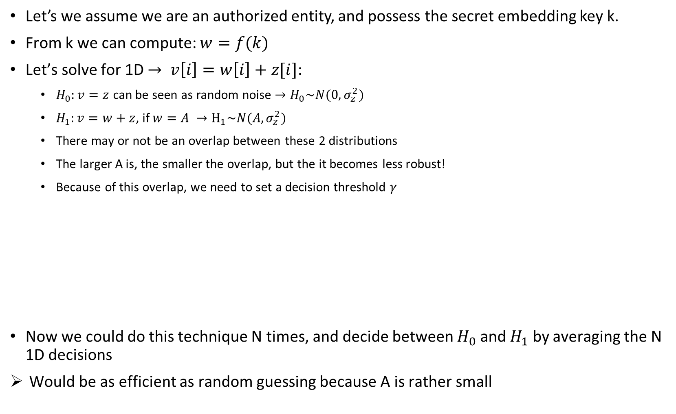
(1.3)
Let’s we assume we are an authorized entity, and possess the secret embedding key k.
From k we can compute: $w=f(k)$
Let’s solve for 1D $→ v\left[i\right]=w\left[i\right]+z[i]$:
$H_{0}:v=z$ can be seen as random noise $→H_{0}\sim N(0,σ_{z}^{2})$
$H_{1}:v=w+z$, if $w=A →H_{1}\sim N(A,σ_{z}^{2})$
There may or not be an overlap between these 2 distributions
The larger A is, the smaller the overlap, but the it becomes less robust!
Because of this overlap, we need to set a decision threshold $γ$
Now we could do this technique N times, and decide between $H_{0}$ and $H_{1}$ by averaging the N 1D decisions
Would be as efficient as random guessing because A is rather small

Slide 11
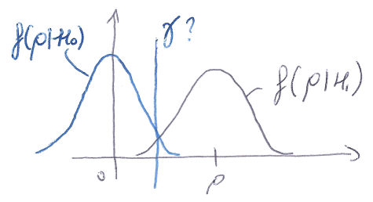
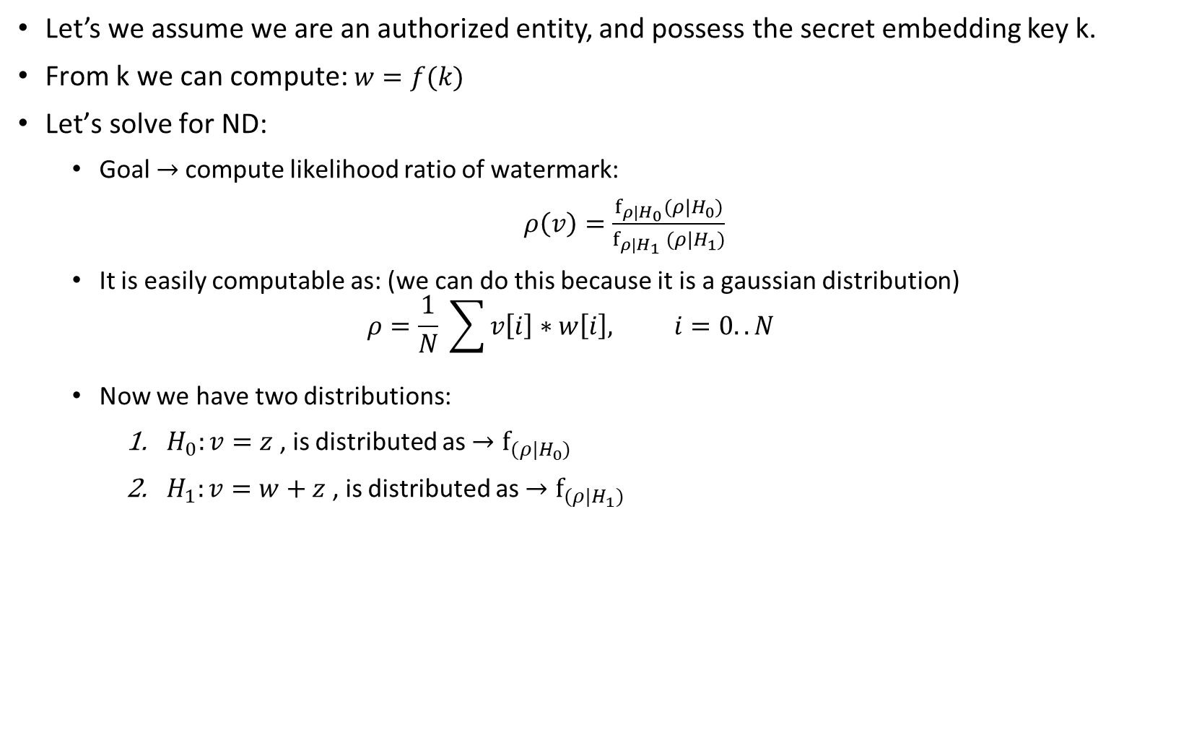
(1.3)
Let’s we assume we are an authorized entity, and possess the secret embedding key k.
From k we can compute: $w=f(k)$
Let’s solve for ND:
Goal $→$compute likelihood ratio of watermark:
$ρ\left(v\right)=\frac{f_{ρ|H_{0}}(ρ|H_{0})}{f_{ρ|H_{1}} (ρ|H_{1})}$
It is easily computable as: (we can do this because it is a gaussian distribution)
$$ρ=\frac{1}{N} \sum{v\left[i\right]∗w\left[i\right], i=0..N}$$
Now we have two distributions:
$H_{0}:v=z$ , is distributed as $→f_{(ρ|H_{0})}$
$H_{1}:v=w+z$ , is distributed as $→f_{(ρ|H_{1})}$

Slide 12
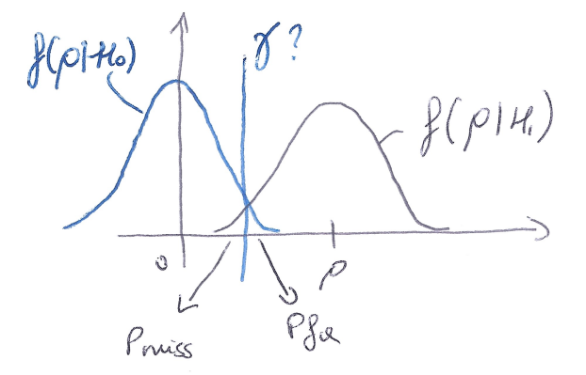
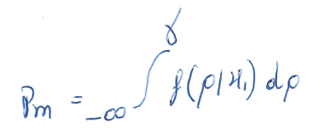
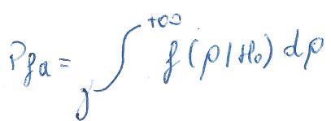
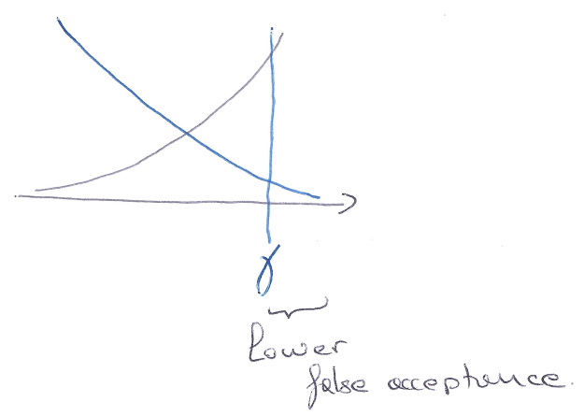
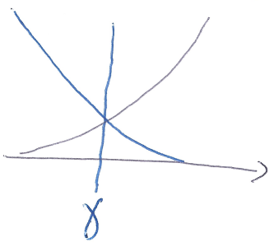
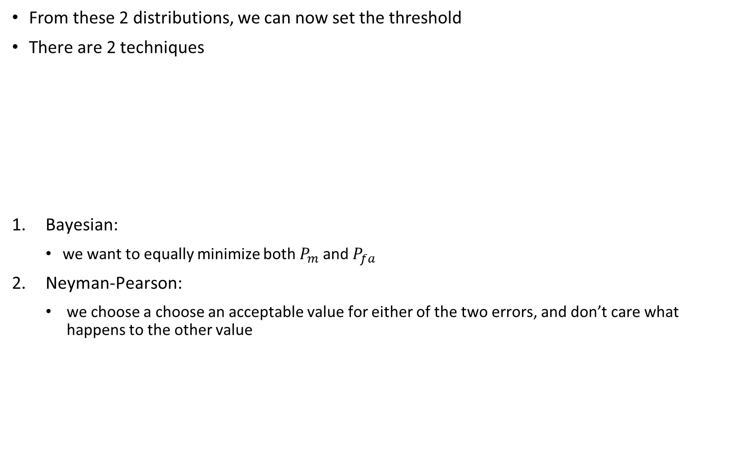
(1.3)
From these 2 distributions, we can now set the threshold
There are 2 techniques
Bayesian:
we want to equally minimize both $P_{m}$ and $P_{fa}$
Neyman-Pearson:
we choose a choose an acceptable value for either of the two errors, and don’t care what happens to the other value

Slide 13
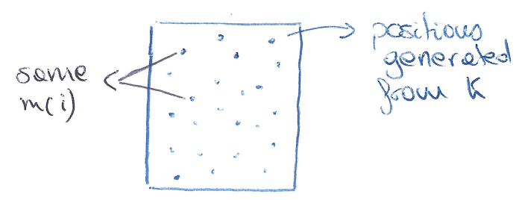
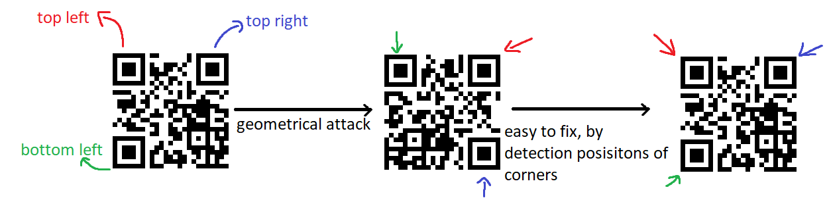
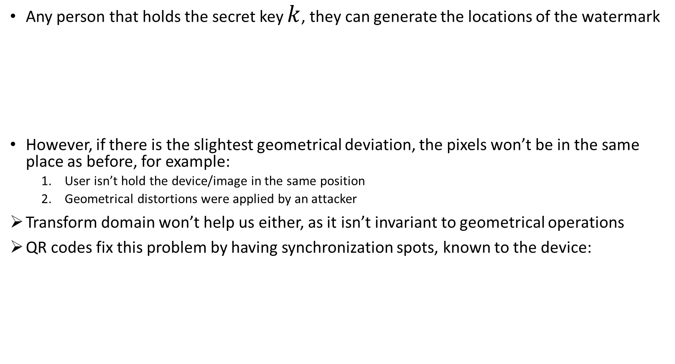
(1.4) Explain the geometrical synchronization problem in the digital watermarking.
Any person that holds the secret key $k$, they can generate the locations of the watermark
However, if there is the slightest geometrical deviation, the pixels won’t be in the same place as before, for example:
User isn’t hold the device/image in the same position
Geometrical distortions were applied by an attacker
Transform domain won’t help us either, as it isn’t invariant to geometrical operations
QR codes fix this problem by having synchronization spots, known to the device:

Slide 14
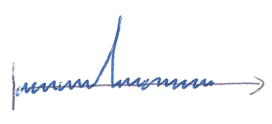
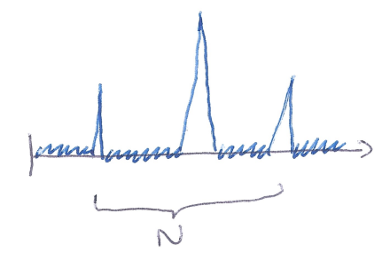
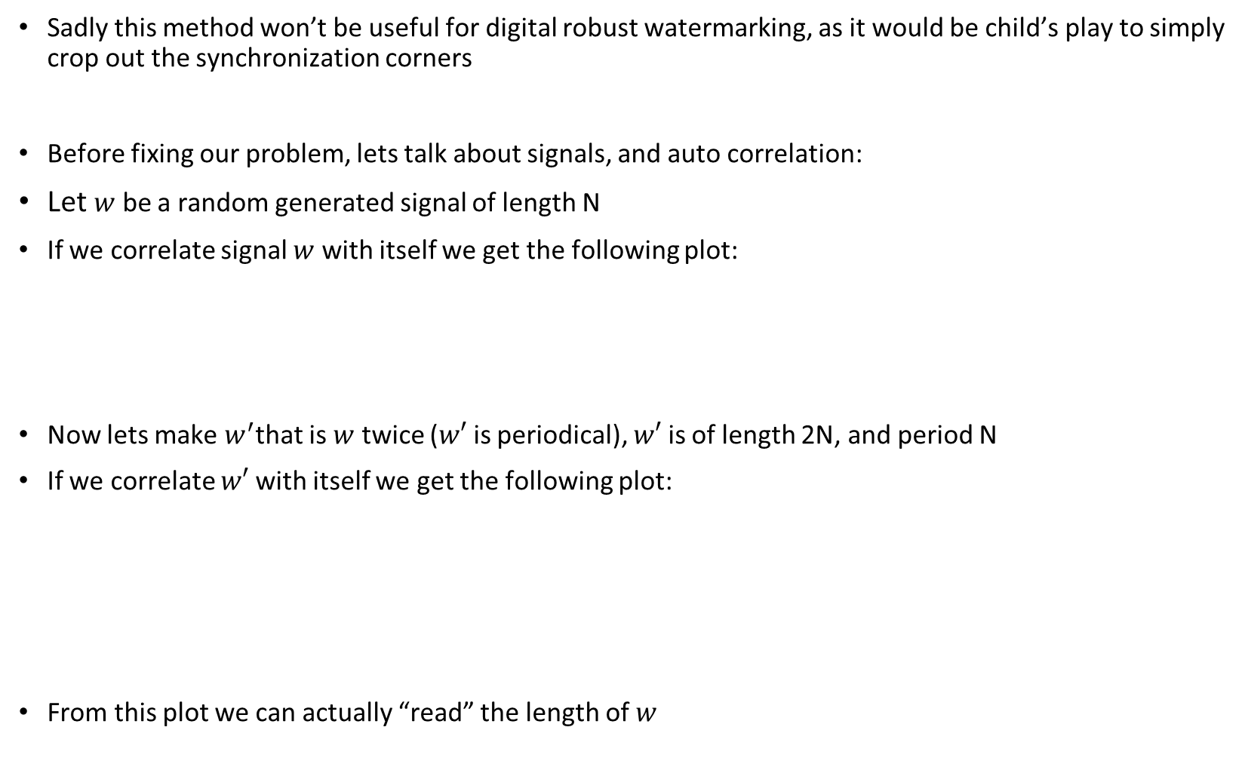
(1.4)
Sadly this method won’t be useful for digital robust watermarking, as it would be child’s play to simply crop out the synchronization corners
Before fixing our problem, lets talk about signals, and auto correlation:
Let $w$ be a random generated signal of length N
If we correlate signal $w$ with itself we get the following plot:
Now lets make $w^{′}$that is $w$ twice ($w′$ is periodical), $w′$ is of length 2N, and period N
If we correlate $w′$ with itself we get the following plot:
From this plot we can actually “read” the length of $w$

Slide 15
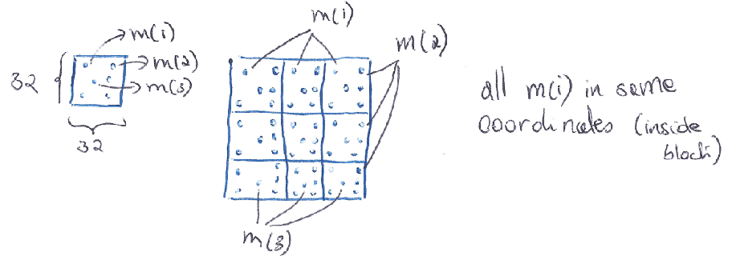
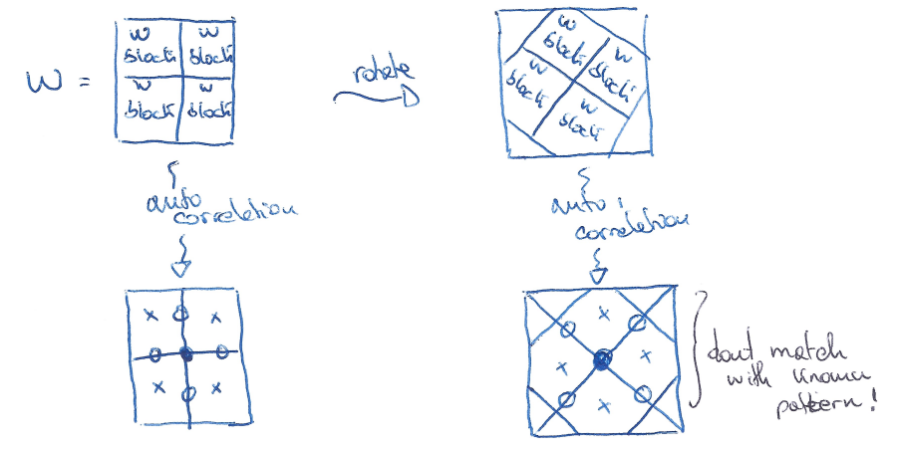
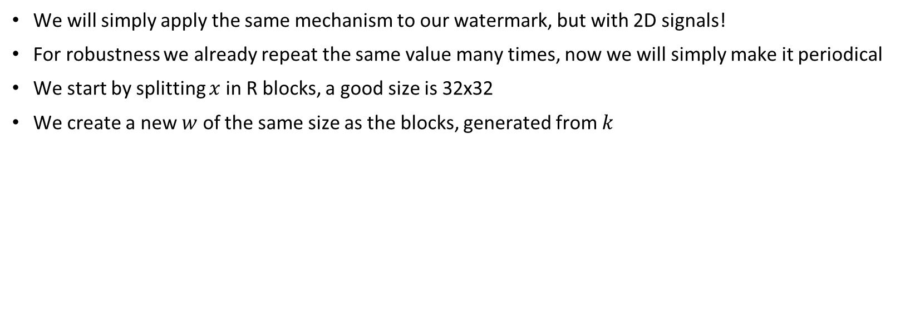
(1.4)
We will simply apply the same mechanism to our watermark, but with 2D signals!
For robustness we already repeat the same value many times, now we will simply make it periodical
We start by splitting $x$ in R blocks, a good size is 32x32
We create a new $w$ of the same size as the blocks, generated from $k$
Lets say we have 4 blocks of repetition, (in practice we will have more)
Auto correlation will look like this:

Slide 16
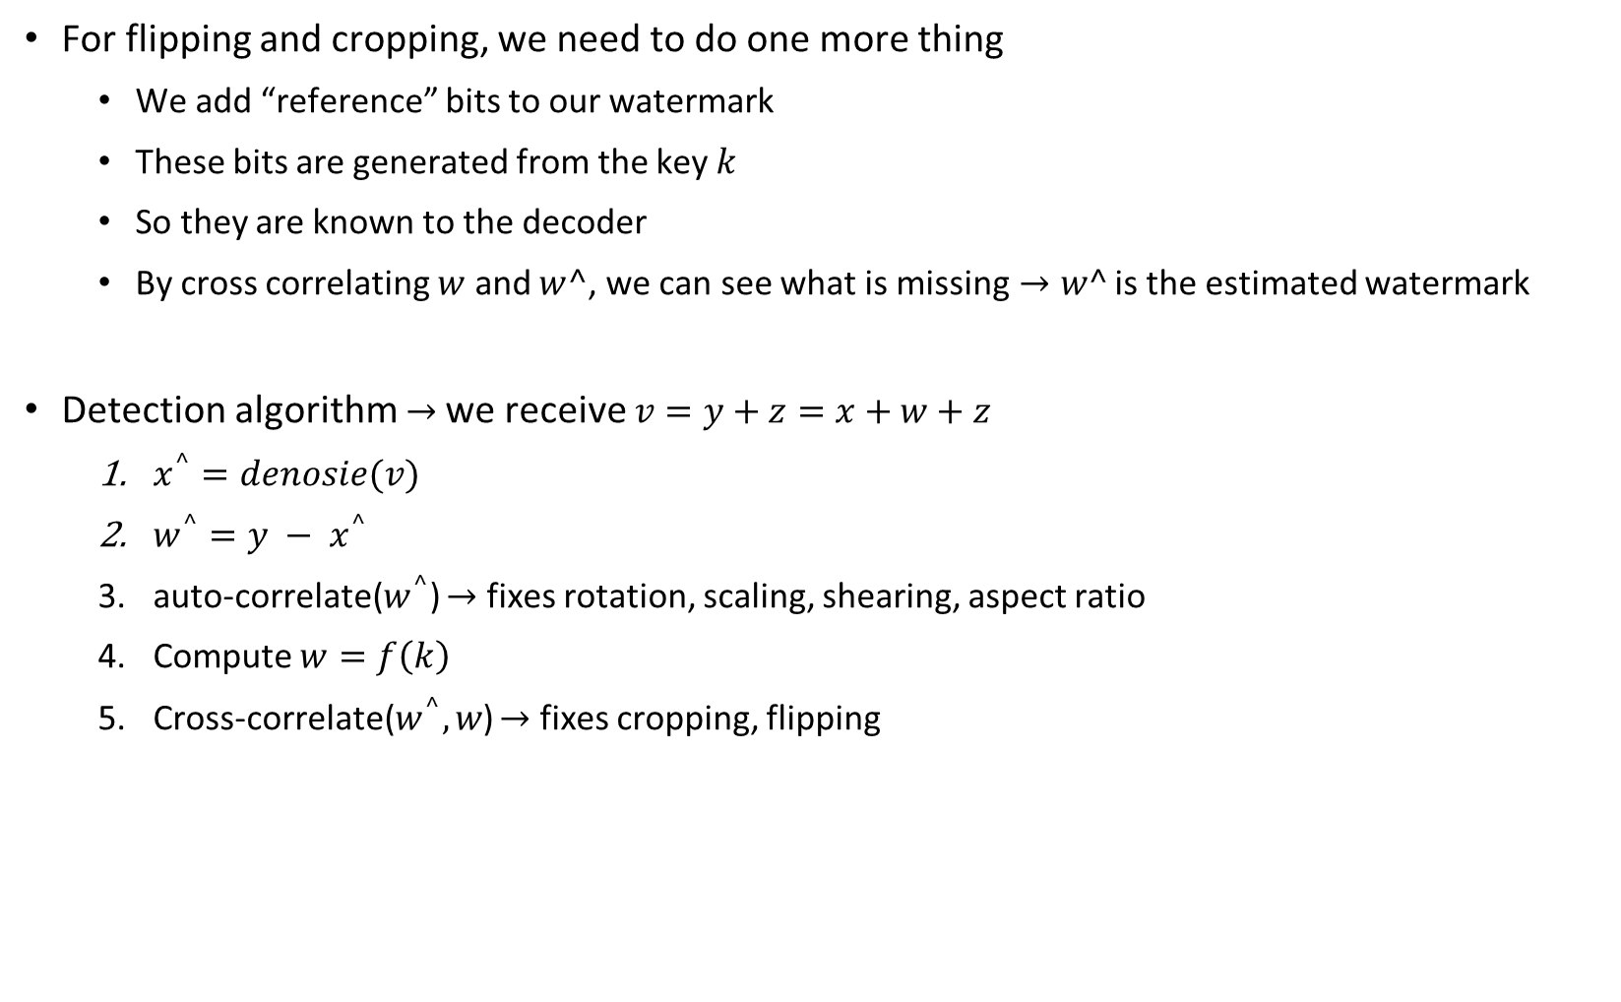
(1.4)
For flipping and cropping, we need to do one more thing
We add “reference” bits to our watermark
These bits are generated from the key $k$
So they are known to the decoder
By cross correlating $w$ and $w^$, we can see what is missing$→w^$ is the estimated watermark
Detection algorithm $→$we receive $v=y+z=x+w+z$
$x^{^}=denosie(v)$
$w^{^}=y − x^{^}$
auto-correlate($w^{^}$) $→$ fixes rotation, scaling, shearing, aspect ratio
Compute $w=f\left(k\right)$
Cross-correlate($w^{^},w$) $→$ fixes cropping, flipping

Slide 17
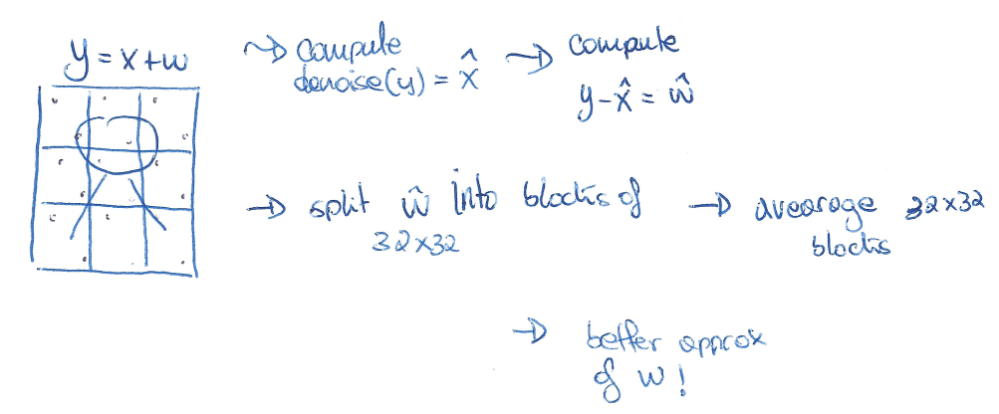
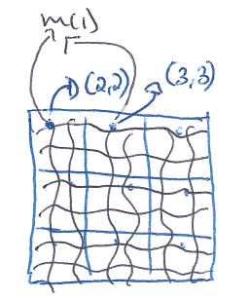
(1.4)
With all this in place, we are unfortunately weak to an averaging attack!
To fix this problem we simply add fluctuations to our periodical watermark
Since it is just small fluctuations we keep all the desired properties
The attacker will no longer be able to perform averaging attack on us

Slide 18
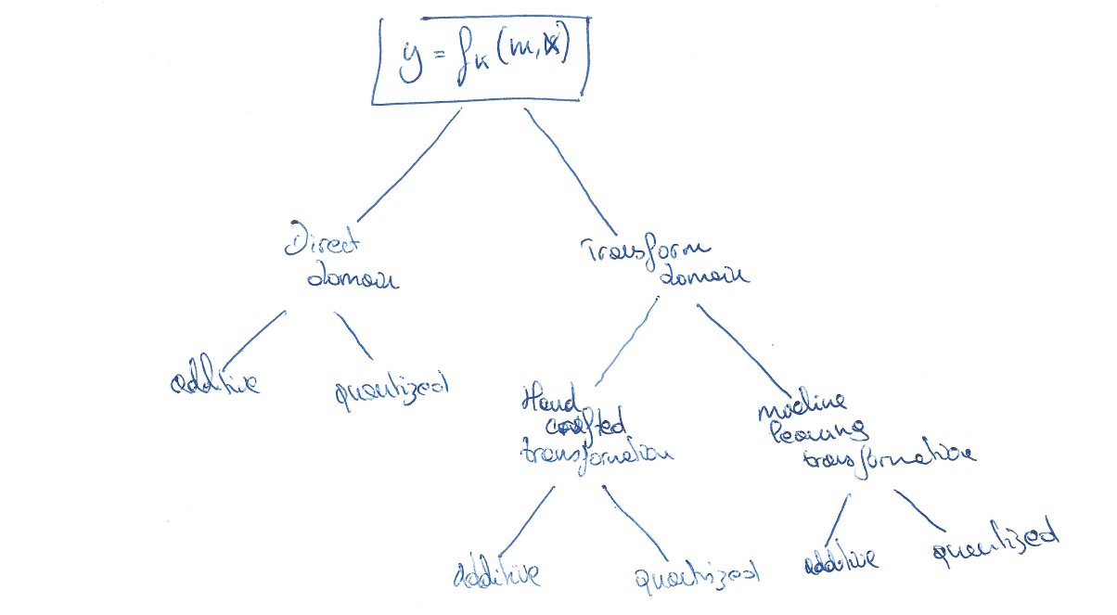
(1.5) Explain the difference between additive and quantization embedding/modulation
Both techniques can be used in the same scenarios
Direct domain
Transform hand crafted domain
Transform machine learning domain
Direct domain can be seen as a transform domain with transform matrix Identity

Slide 19
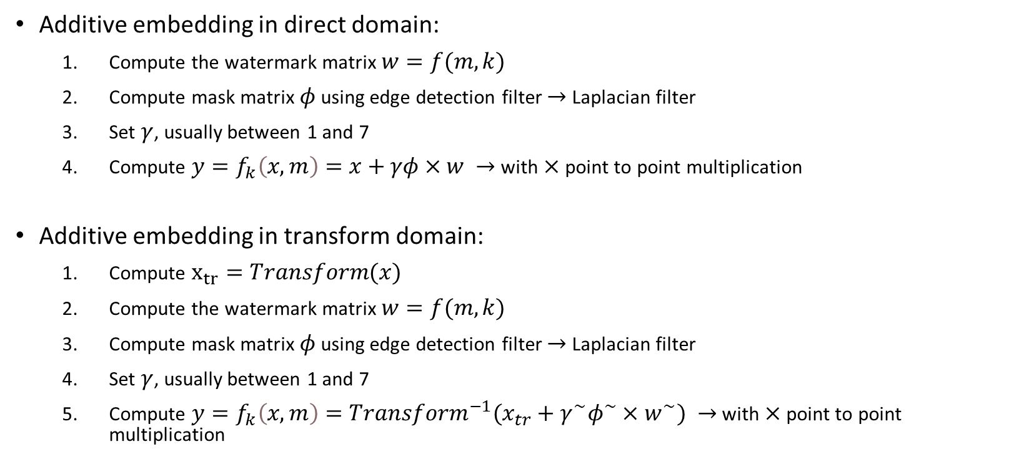
(1.5)
Additive embedding in direct domain:
Compute the watermark matrix $w=f(m,k)$
Compute mask matrix $φ$ using edge detection filter $→$Laplacian filter
Set $γ$, usually between 1 and 7
Compute $y=f_{k}\left(x,m\right)=x+γφ×w →$with $×$ point to point multiplication
Additive embedding in transform domain:
Compute $x_{tr}=Transform(x)$
Compute the watermark matrix $w=f(m,k)$
Compute mask matrix $φ$ using edge detection filter $→$Laplacian filter
Set $γ$, usually between 1 and 7
Compute $y=f_{k}\left(x,m\right)=Transform^{−1}(x_{tr}+γ^{\sim }φ^{\sim }×w^{\sim }) →$with $×$ point to point multiplication

Slide 20
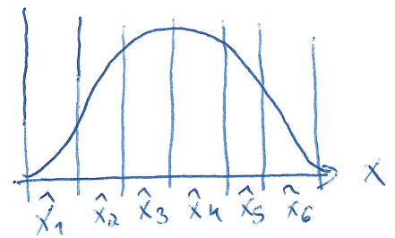
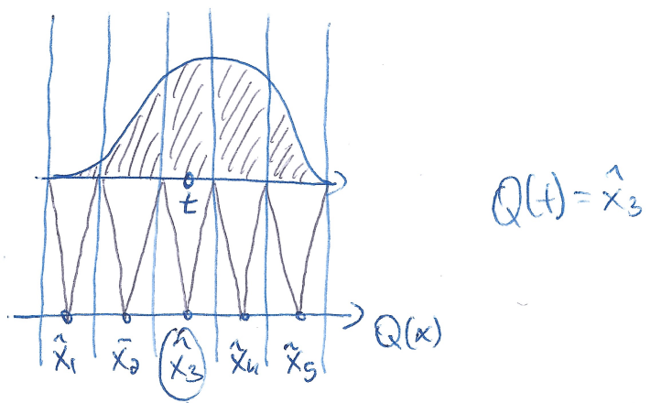
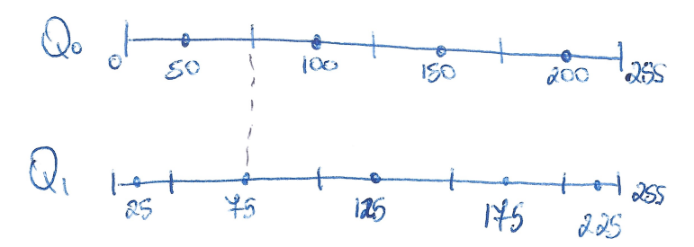
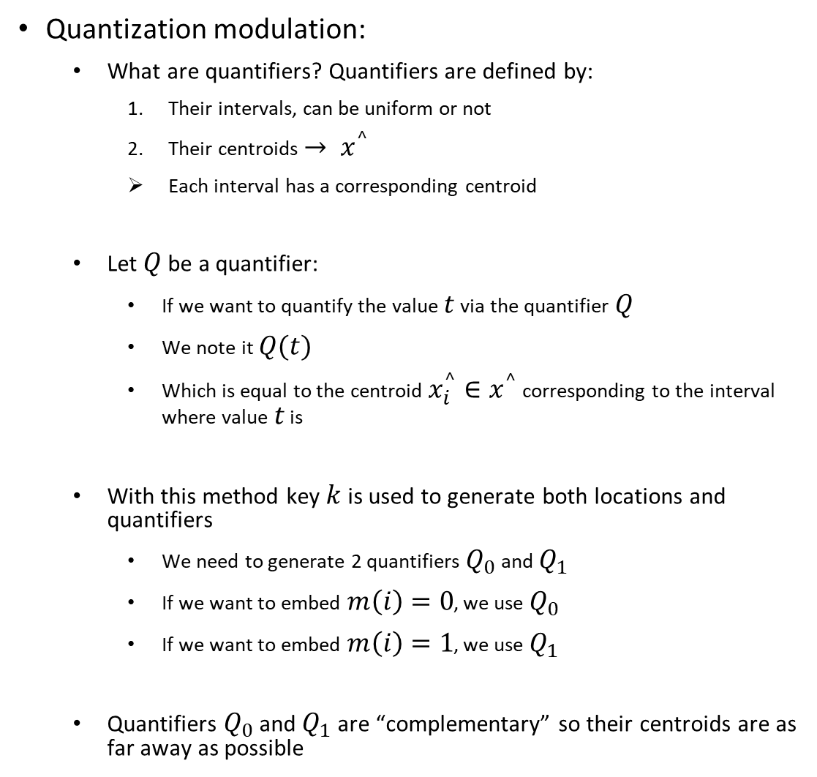
(1.5)
Quantization modulation:
What are quantifiers? Quantifiers are defined by:
Their intervals, can be uniform or not
Their centroids $→ x^{^}$
Each interval has a corresponding centroid
Let $Q$ be a quantifier:
If we want to quantify the value $t$ via the quantifier $Q$
We note it $Q(t)$
Which is equal to the centroid $x_{i}^{^}∈x^{^}$ corresponding to the interval where value $t$ is
With this method key $k$ is used to generate both locations and quantifiers
We need to generate 2 quantifiers $Q_{0}$ and $Q_{1}$
If we want to embed $m\left(i\right)=0$, we use $Q_{0}$
If we want to embed $m\left(i\right)=1$, we use $Q_{1}$
Quantifiers $Q_{0}$ and $Q_{1}$ are “complementary” so their centroids are as far away as possible

Slide 21
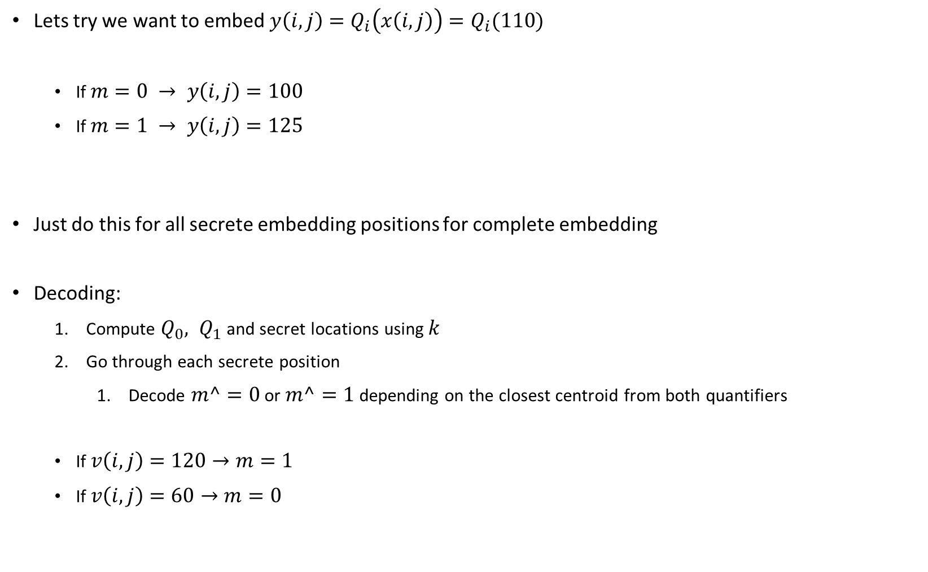
(1.5)
Lets try we want to embed $y\left(i,j\right)=Q_{i}\left(x\left(i,j\right)\right)=Q_{i}(110)$
If $m=0 → y\left(i,j\right)=100$
If $m=1 → y\left(i,j\right)=125$
Just do this for all secrete embedding positions for complete embedding
Decoding:
Compute $Q_{0}, Q_{1}$ and secret locations using $k$
Go through each secrete position
Decode $m^=0$ or $m^=1$ depending on the closest centroid from both quantifiers
If $v\left(i,j\right)=120→m=1$
If $v\left(i,j\right)=60→m=0$

Slide 22
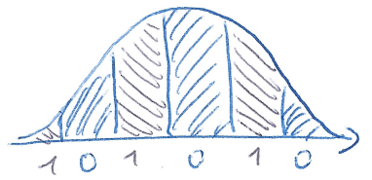
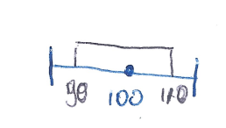
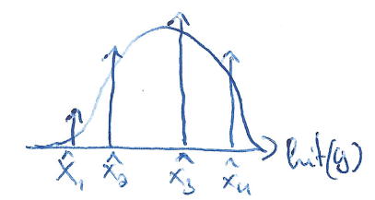
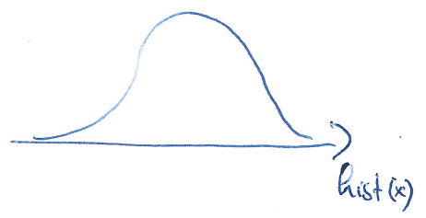
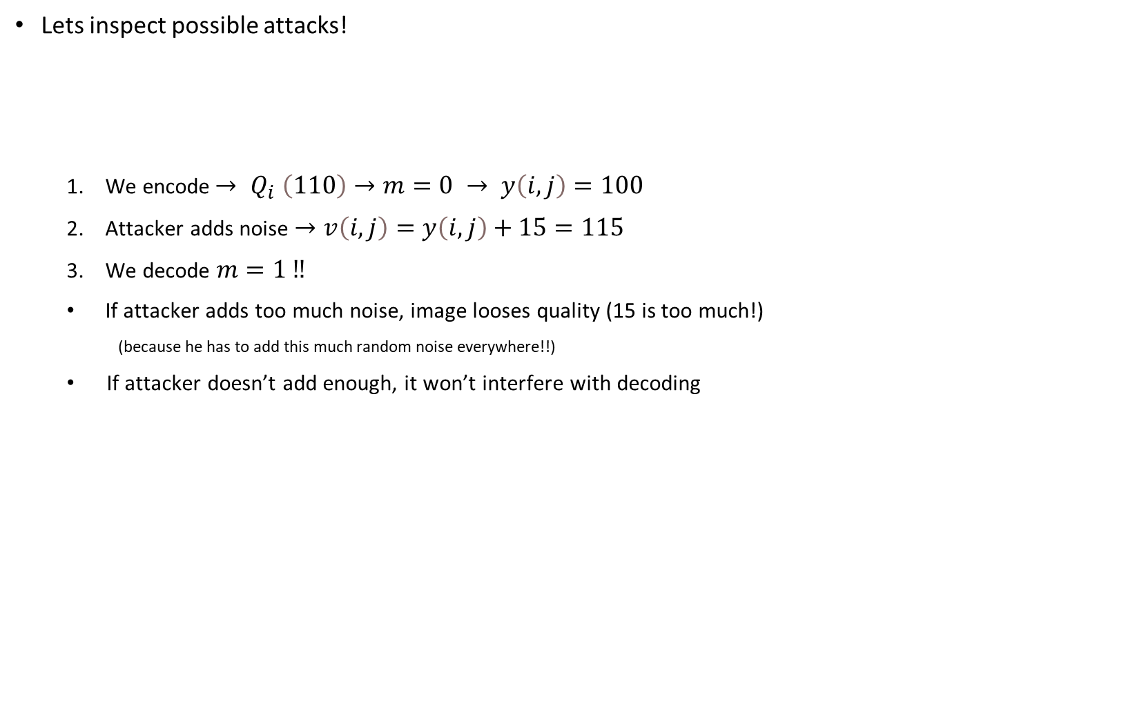
(1.5)
Lets inspect possible attacks!
We encode${→ Q}_{i}\left(110\right)→m=0 → y\left(i,j\right)=100$
Attacker adds noise $→v\left(i,j\right)=y\left(i,j\right)+15=115$
We decode $m=1 ‼$
If attacker adds too much noise, image looses quality (15 is too much!)
(because he has to add this much random noise everywhere!!)
If attacker doesn’t add enough, it won’t interfere with decoding

Slide 23
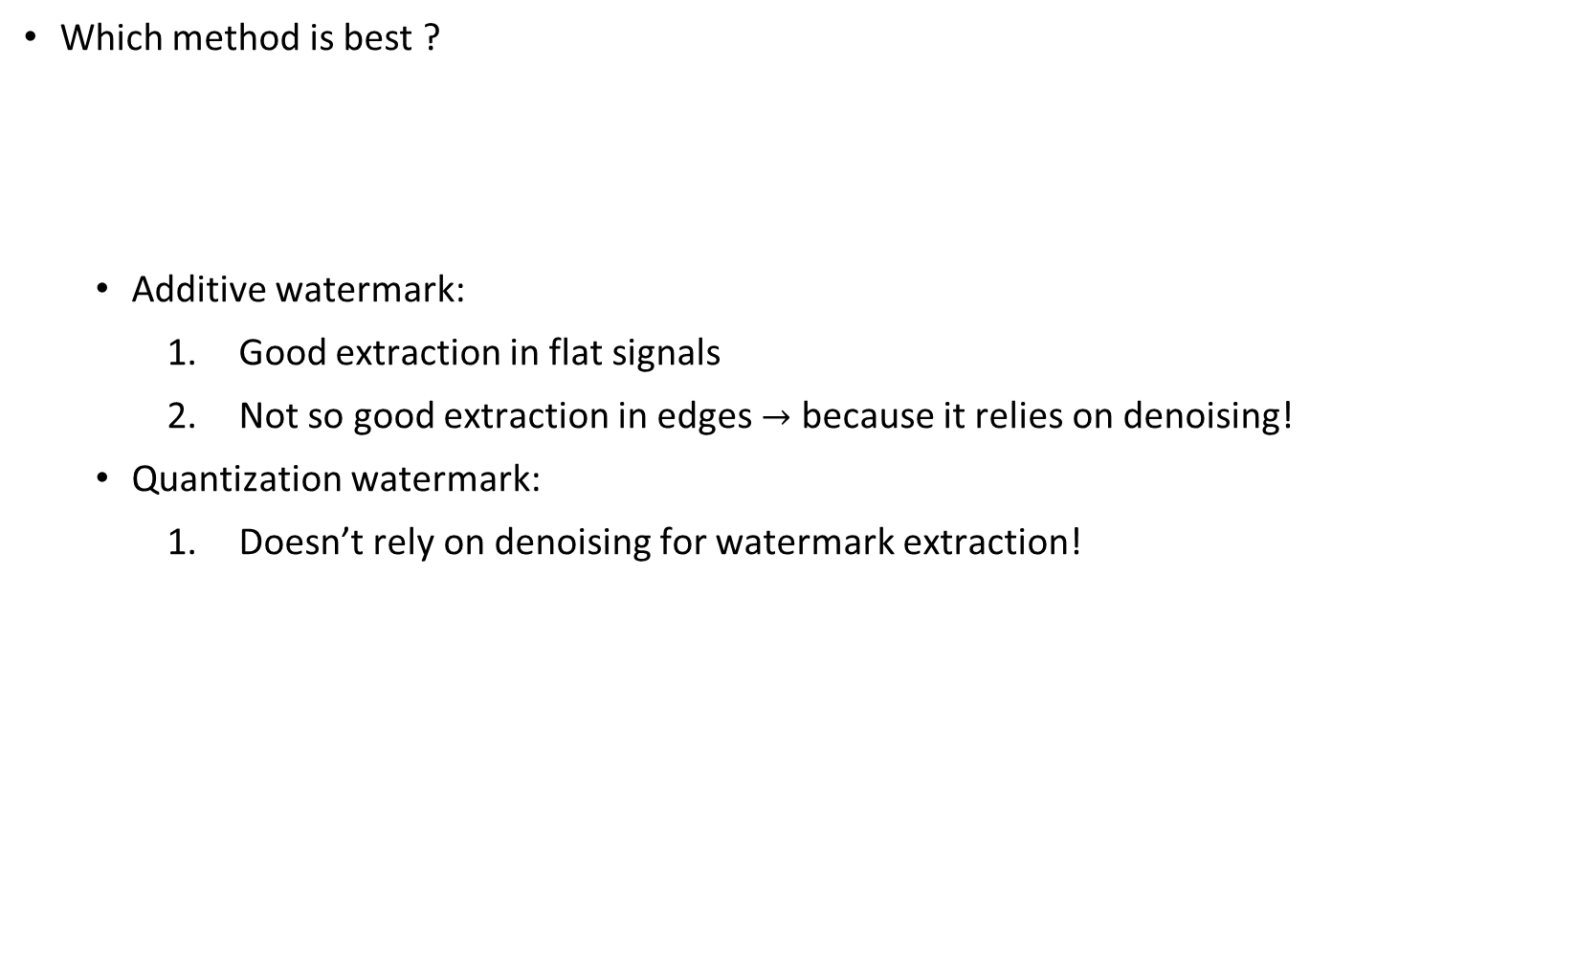
(1.5)
Which method is best ?
Additive watermark:
Good extraction in flat signals
Not so good extraction in edges $→$ because it relies on denoising!
Quantization watermark:
Doesn’t rely on denoising for watermark extraction!

Slide 24
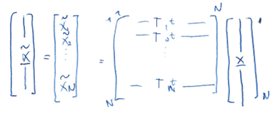
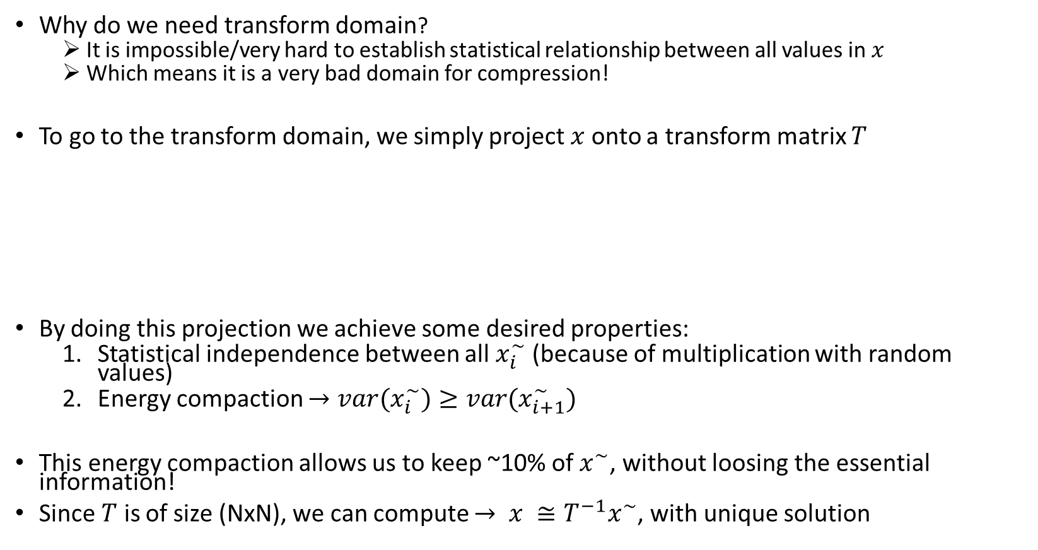
(1.6) Explain digital watermarking in the transform domain. What are the main advantages?
Why do we need transform domain?
It is impossible/very hard to establish statistical relationship between all values in $x$
Which means it is a very bad domain for compression!
To go to the transform domain, we simply project $x$ onto a transform matrix $T$
By doing this projection we achieve some desired properties:
Statistical independence between all $x_{i}^{\sim }$ (because of multiplication with random values)
Energy compaction ${→var(x}_{i}^{\sim })≥var{(x}_{i+1}^{\sim })$
This energy compaction allows us to keep ~10% of $x^{\sim }$, without loosing the essential information!
Since $T$ is of size (NxN), we can compute $→ x ≅T^{−1}x^{\sim }$, with unique solution

Slide 25
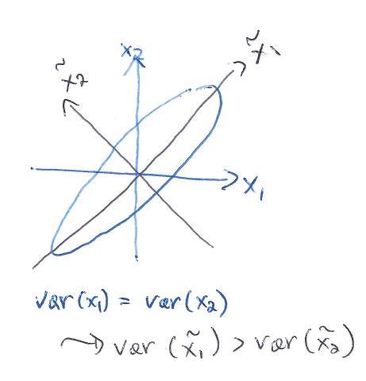
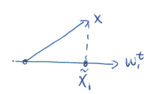
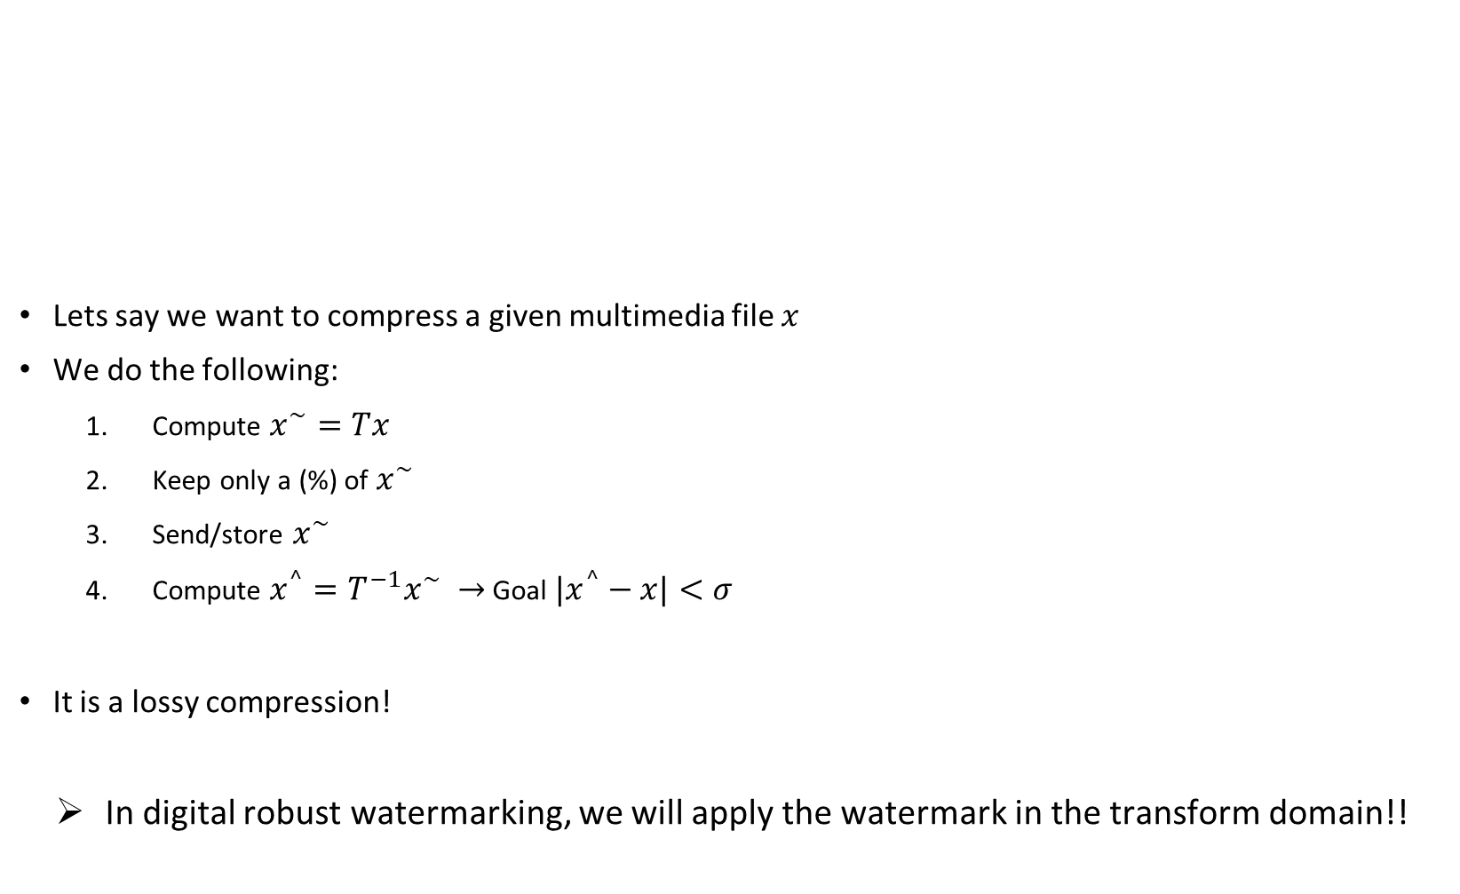
(1.6)
Lets say we want to compress a given multimedia file $x$
We do the following:
Compute $x^{\sim }=Tx$
Keep only a (%) of $x^{\sim }$
Send/store $x^{\sim }$
Compute $x^{^}=T^{−1}x^{\sim } →$ Goal ${|x}^{^}−x|<σ$
It is a lossy compression!
In digital robust watermarking, we will apply the watermark in the transform domain!!

Slide 26
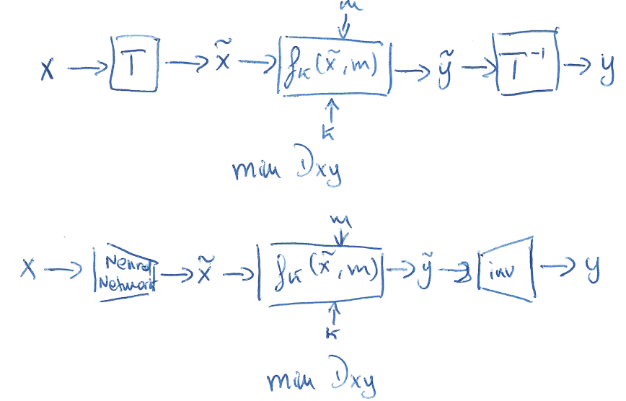
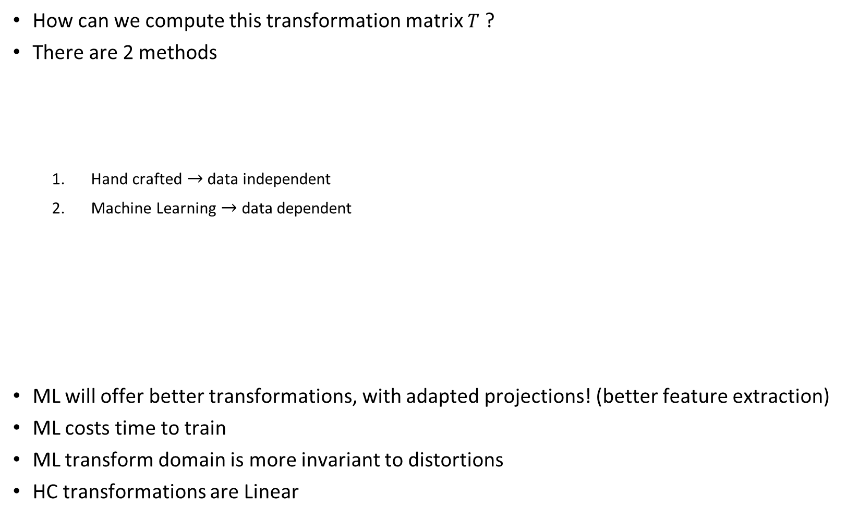
(1.6)
How can we compute this transformation matrix $T$ ?
There are 2 methods
Hand crafted $→$ data independent
Machine Learning $→$ data dependent
ML will offer better transformations, with adapted projections! (better feature extraction)
ML costs time to train
ML transform domain is more invariant to distortions
HC transformations are Linear

